Slide 1

Age Group Changes and Participation Update James Williams – CEO Welsh Athletics, Chair – Age Group Task Group

Slide 2


This Evening….
An Update on Age Group change
Technical information
Indoor Season 2026
Welsh Junior League Format 2026 onwards
Welsh Championships
Schools Athletics
Not a discussion about whether Change should happen
Not a discussion about desired changes to the technical specifications

Slide 3
Age Group Change – the story so far….
Backed by research, a change to reduce drop-out rate in the sport (part of wider activity to address retention)
Avoid clash with key education/competition impact on key age groups (U17)
Closer alignment with the rest of the World
Extensive consultation and engagement with the sport
Change approved by the Board of UKA
Implementation April 2026
Close alignment with England Athletics

Slide 4
Age Group Change – the story so far….
World Athletics Rule Book – ultimate guide to the sport
UK Athletics Rule Book
Alignment where possible
Have become closer to World Athletics in recent years
Age Groups is an anomaly
Welsh Athletics signs up to the UKA Rule book in totality
Rules Advisory Group – Independent group, provides guidance to Board of UKA
NOT looking to fully align with World Athletics Age Groups (Jan 1st)

Slide 5
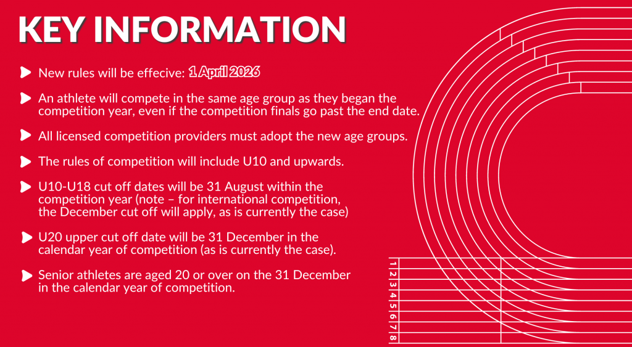

Slide 6


Slide 7
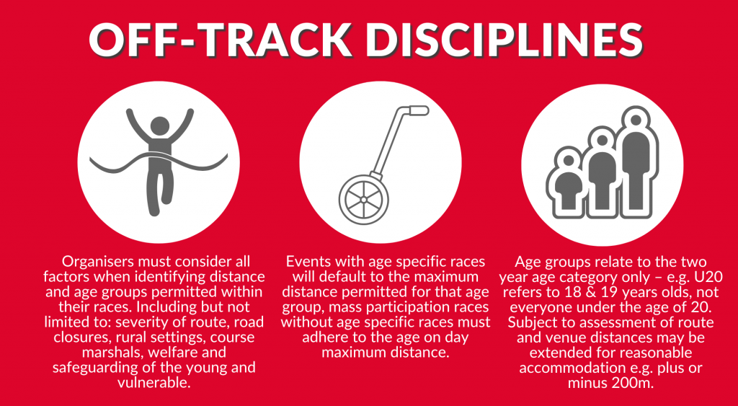

Slide 8
New Age Groups
Event Progressions

Slide 9

Age Group Change process
UK Wide Task Group – UKA/HCAF + independents (open recruitment)
Specific sub-groups established to review key aspects of change process
Event Specific
Hurdles
Throws
Combined Events
IT Challenges
Off-Track
Records
Liaison with Rules advisory group
Several Webinars throughout last 12 months
Liaison with Competition Providers
Tested & refined continuously – now finalized – approved technical spec by UKA Board

Slide 10
Overarching Principles
Flexibility: There should be a level of flexibility in event distances for the younger age groups to allow them to run shorter distances if not fit enough or slightly longer, if appropriate to do so. Helping reach and engage the biggest audience.
Health & Safety and Appropriateness: New events being introduced will be reviewed to ensure all necessary Risk Assessments have been applied and the event is introduced with the long-term development of the athlete in mind.
Offering something different: Encouraging competition providers to offer alternative competitions, such as athletes selecting the best hurdle height and spacing for them, not by age; which athlete can improve the most; bio-banding type competitions.
Equipment: We will work with equipment providers to ensure they have the correct stock ahead of new events.
Number of Events per day/ competition: The rule book is under review and we will further clarify why limitations on the number events an athlete can participate in have been applied with certain age groups.

Slide 11
Q – What are the new distances/spacing/throwing weights etc for the new Age groups?

Slide 12
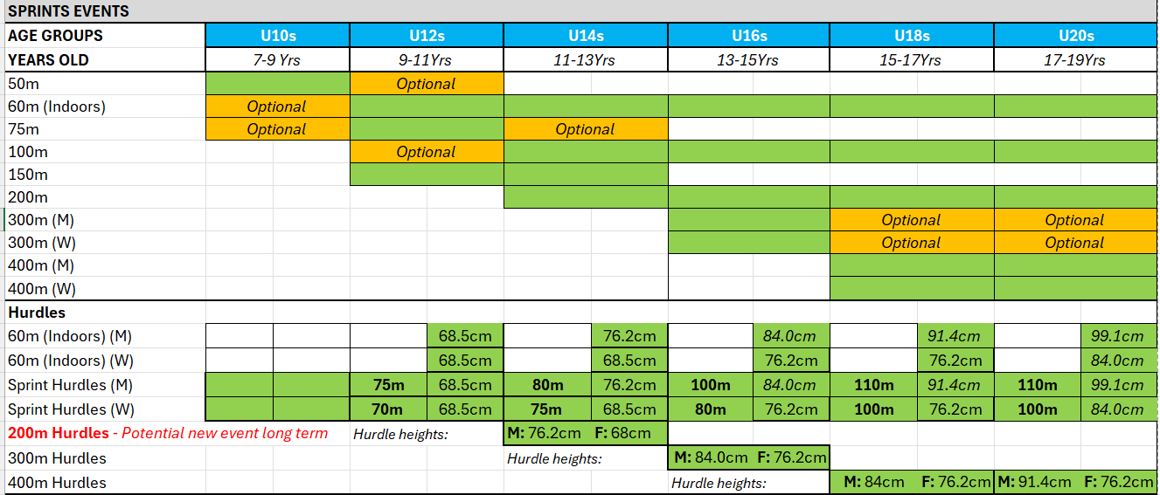
Appropriate Competition Offer - Speed

Slide 13
Q - What about hurdle heights and spacings. Won’t these be harder in the New Age Groups?
Whilst for some athletes the hurdle distance may go out earlier, the height will stay lower for longer, allowing them to run with greater speed and confidence.

Slide 14
Headline Points for Sprints Events
Sprints Events per Age Group
U10s: 50m key event. Option to do 75m and 60m (Indoors)
U12s: 60m (indoors), 75m and 150m key events. Option to do 50m or 100m.
U14s: 60m (indoors), 100m, 150m, 200m key events. Option to do 75m.
U16s: 60m (indoors), 100m, 200m, 300m key events.
U18 & U20s: 60m (indoors), 100m, 200m, 400m key events. Option to do 300m.
Main Points
Providing athletes and competition providers with the flexibility at the younger age groups to increase or decrease some distances for athlete’s development.
All proposed events have existing start and finish lines on a standard track.
Indoors sprints events to include 60m, 200m, 300m, 400m aligned with outdoor age group distances.

Slide 15
Headline Points for Hurdles Events
Hurdle Events per Age Group
Indoors: 60m Hurdles for both genders and U12s to Senior age groups (with appropriate hurdle heights and spacings).
U12s: 70m H (F) & 75m H (M) outdoors
U14s: 75m H (F) & 80m H (M), 200m Hurdles (M&F) New event outdoors
U16s: 80m H (F) & 100m H (M), 300m Hurdles (M&F) Outdoors
U18 & U20s: 100m H (F) & 110m H (M), 400m Hurdles (M&F) Outdoors
Main Points
Hurdles will stay lower for one year longer, but in most cases will move out in distance. This is to allow athletes to maintain speed when running over the hurdles and build confidence in the event for long term progression.
The introduction of 200m Hurdles for U14 is a new event
There will be NO new track markings required for the new age groups
A full outline of hurdle specifications are proposed the next few slides.

Slide 16
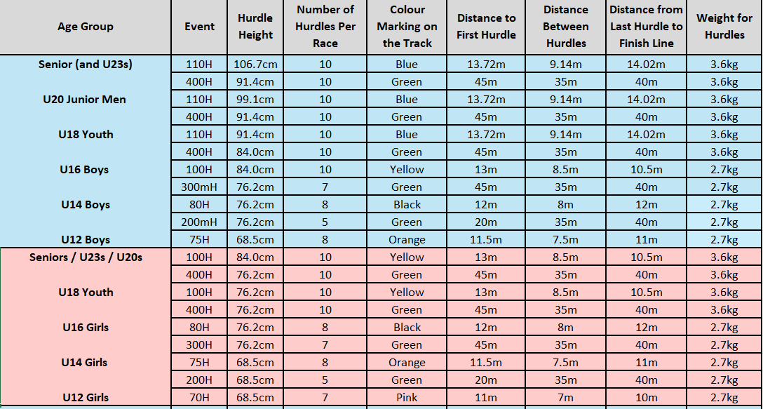
Hurdles Technical Details in Full

Slide 17
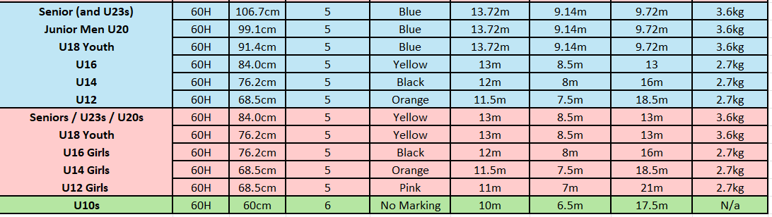
Hurdles Technical Details in Full

Slide 18
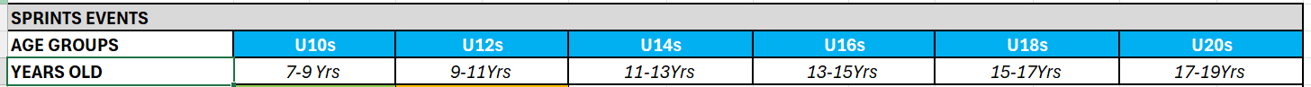
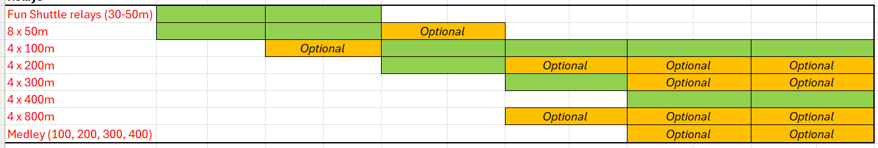
Appropriate Competition Offer – Speed (Relays)
Headline Points for Relays
Relay distances should align with the age group individual event distance (i.e. 4 x 300m is for U16s upwards).
A variety of distances can be offered, but they should reflect the long-term event development, age-appropriate distances, engage as many athletes as possible, an offer fun and teamwork.

Slide 19
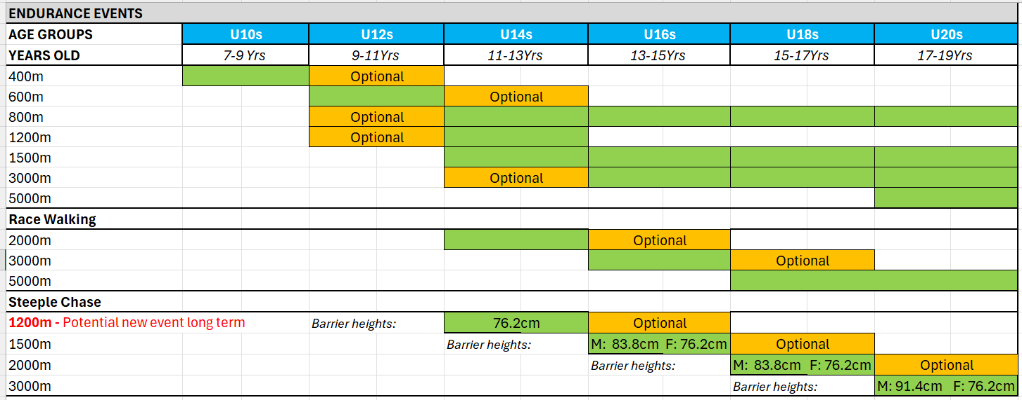
Appropriate Competition Offer - Endurance

Slide 20
Headline Points for Endurance Events - Flats
Endurance Events per Age Group
U10s: 400m Endurance. Option to do 600m Endurance.
U12s: 600m Endurance. Option to do either 400m Endurance or 800m.
U14s: 800m, 1200m or 1500m. Option to 600m or 3000m
U16s & U18s: 800m, 1500m and 3000m
U20s: 800m, 1500m, 3000m, 5000m and 10,000m
Main Points
Providing athletes and competition providers with the flexibility at the younger age groups to increase or decrease some distances for athlete’s development.
All proposed events have existing start and finish lines on a standard track.
For clarity, the 400m and 600m should be defined as specifically endurance events to save and conflict or confusion with the introduction of 400m sprints at a later age group.

Slide 21
Headline Points for Endurance Events – RW & SC
Steeplechase per Age Group
U14s: 1200m
U16s: 1500m. Optional 1200m.
U18s: 2000m. Optional 1500m
U20s: 3000m. Optional 2000m.
Race Walking per Age Group
U14s: 2000m
U16s: 3000m. Optional 2000m.
U18s & U20s: 5000m. Optional 3000m.
Main Points
Providing athletes and competition providers with the flexibility at the younger age groups to increase or decrease some distances for athlete’s development.
The introduction of 1200m Steeplechase for U14 is a proposed new event, to help with long term development.
A full outline of Steeplechase specifications are proposed the next slide.

Slide 22
Off-track disciplines
The below table highlights MAXIMUM permitted distances for all athletes in differing disciplines. Further recommendations are listed for race distances for cross country, road and multi-terrain events.
Note: we are still awaiting sign off from the Mountain, Hill and Fell group; an update will be issued soon.
Age group | Age on day | All terrains: maximum distances | Cross Country: recommended distances | Road and Multi-terrain: recommended distances
Senior / Master (20+) | 20+ | Unlimited | Unlimited | Unlimited
U20 (18, 19) | 19 18 | 45km Marathon | 10km | Marathon
U18 (16, 17) | 17 16 | 25km 16km | 8km | 16km
U16 (14, 15) | 15 14 | 12km 8km | 5km | 8km
U14 (12, 13) | 13 12 | 6km 6km | 4km | 6km
U12 (10, 11) | 11 10 | 3km 3km | 3km | 3km

Slide 23
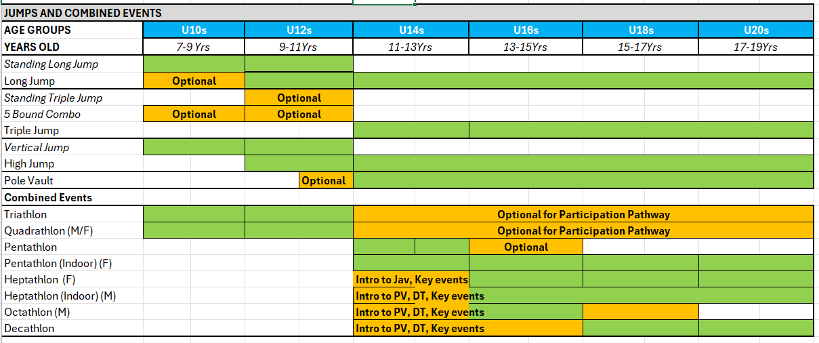
Appropriate Competition Offer – Jumps & CE

Slide 24
Headline Points for Jumps Events
Jumps Events per Age Group
U10s: Standing Long Jump (SLJ) & Vertical Jump. Optional Long Jump.
U12s: SLJ, Long Jump, Standing Triple Jump (STJ), High Jump. Optional Pole Vault for top year U12s.
U14s: Long Jump, Triple Jump, High Jump and Pole Vault
U16, U18 & U20s: Long Jump, Triple Jump, High Jump and Pole Vault
Main Points
Recommended guidelines on using restricted run ups for Long Jump (U10s – U14s), and Triple Jump (U14s) to minimize impact on the developing body.
Need for some level of guidance for all jumps events on the long term development of the event.

Slide 25
Headline Points for Combined Events
Combined Events per Age Group
U10s: Triathlon or Quadrathlon. Events include 50m, 400m, SLJ and Howler Throw
U12s: Triathlon or Quadrathlon. Events include 75m, 600m, SLJ/LJ and Howler Throw
U14s: Pentathlon (M&F) Indoor and out
U16: Girls - Pentathlon (Indoors) Heptathlon (Outdoors), Boys - Heptathlon (Indoors), Octathlon (Outdoors)
U18 & U20: Girls - Pentathlon (Indoors) Heptathlon (Outdoors), Boys - Heptathlon (Indoors), Decathlon (Outdoors)
Main Points
Early introduction of more technical events is recommended, either within the combined events or separately to help with later development.
All event specifications should align with individual events at the same age groups.
Triathlon and Quadrathlon competitions can be used at any age group as a fun, participation model.
Combined Events group are currently reviewing what events should be in the Pentathlon and Octathlon and whether Hexathlon should be used through the age groups.

Slide 26
What about Implement Weights. Will they be heavy or Lighter in the New Age Groups?
In most cases implements will be lighter for one year longer

Slide 27
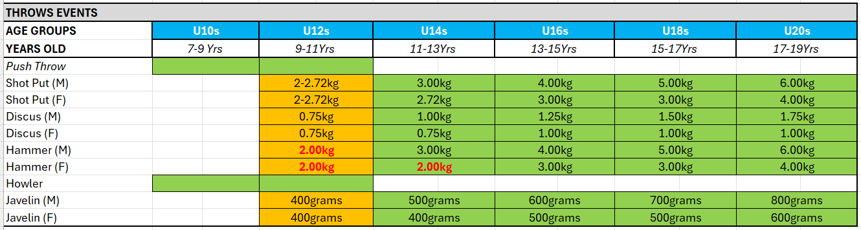
Appropriate Competition Offer - Throws

Slide 28
Headline Points for Throwing Events
MALE ATHLETES IMPEMENT WEIGHTS
Age | SHOT - Club | DISCUS - Club | HAMMER - Club | JAVLEIN - Club
Senior | 7.26 kg | 2.00 kg | 7.26 kg | 800gram
U20 | 6.00 kg | 1.75 kg | 6.00 kg | 800gram
U18 | 5.00 kg | 1.5 kg | 5.00 kg | 700gram
U16 | 4.00 kg | 1.25 kg | 4.00 kg | 600gram
U14 | 3.00 kg | 1.00 kg | 3.00 kg | 500gram
U12 | 2- 2.72 kg | 0.75 kg | 2.00 kg | 400gram
FEMALE ATHLETES IMPEMENT WEIGHTS
Age | SHOT - Club | DISCUS - Club | HAMMER - Club | JAVLEIN - Club
Senior | 4.00 kg | 1.00 kg | 4.00 kg | 600gram
U20 | 4.00 kg | 1.00 kg | 4.00 kg | 600gram
U18 | 3.00 kg | 1.00 kg | 3.00 kg | 500gram
U16 | 3.00 kg | 1.00 kg | 3.00 kg | 500gram
U14 | 2.72 kg | 0.75 kg | 2.00 kg | 400gram
U12 | 2- 2.72 kg | 0.75 kg | 2.00 kg | 400gram
Throws implements
The new Age Group throwing implement weights will mean that athletes for most events and age groups, will throw lighter for one year longer.
This is not the case in the female U16 Shot, Hammer and Javelin and for most female Discus age groups, as the progression are slightly less pronounced than in the men’s events.
All throwing implement weights conform with the current equipment used in competitions and in general circulation, except for the U14 Female Hammer. It is recommended for long term development that the U14 female athletes use a 2kg Hammer (currently available in training Hammer format with most equipment providers in the UK).
Option to introduce U12s Hammer (if appropriate), using the 2.00 kg Hammer.

Slide 29
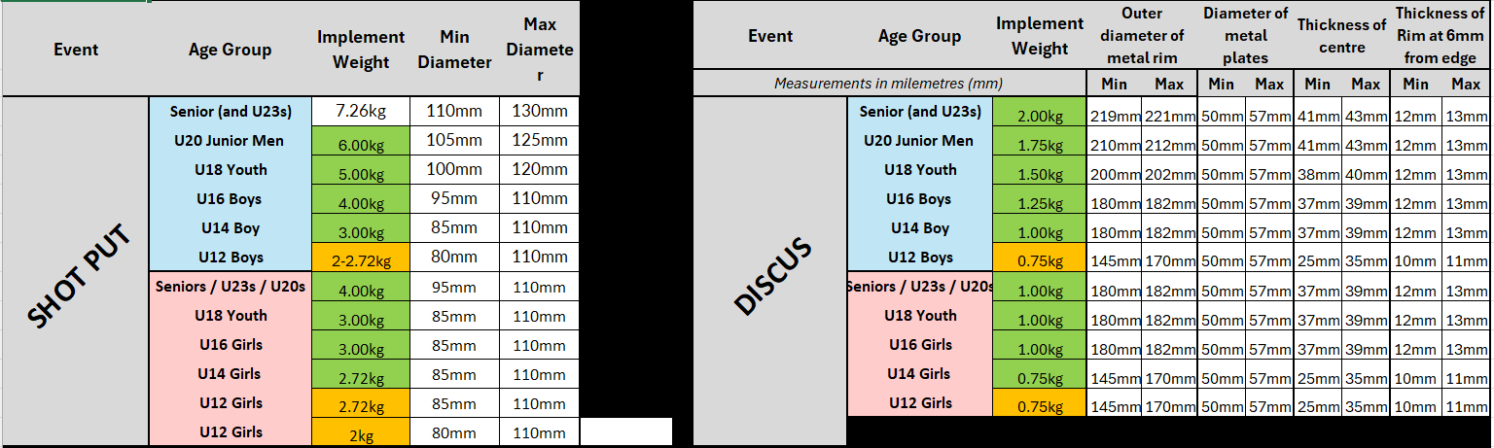
Shot & Discus Details in Full

Slide 30
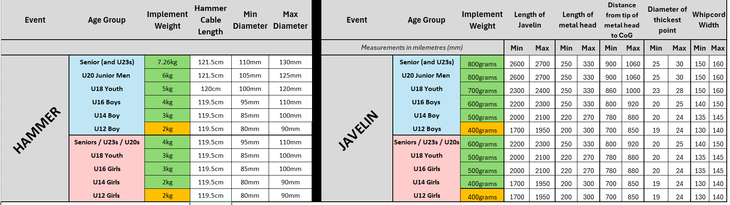
Hammer & Javelin Details in Full
Javelin Specification will be updated to the new configurations ahead of April 2026
U12s Hammer has been proposed as a suggested optional event, if appropriate

Slide 31
Specific Welsh Update
Indoor Season 2026
A need to align with England (cross border events, British Age group Championships)
A decision to retain current age groups (U13/U15/U17/U20) for 2026 Indoor season
Welsh Athletics would support some pilot events in technical events during Indoor season – contact Welsh Athletics to discuss further

Slide 32
Specific Welsh Update
Welsh Championships
Will run in similar formats from U14 through to U20 (+ Snr)
Welsh Junior Leagues
Aim to minimise change for the Junior Leagues
U12, U14 & U16
Enhanced event specific programme for U18/U20/Snr
New informal competition offering to be rolled out for U10/U12

Slide 33
Specific Welsh Update
Schools Athletics
All licensed events in Wales must adhere to the new rules
A desire to avoid issues with differing technical specification between club and Schools Athletics
As it stands – WSAA likely to adopt new age groups
Cup/Plate already use even age groups
However….. English Schools yet to commit to new age groups
Uncertainty on how this will impact SIAB
Discussions ongoing….

Slide 34



THANK YOU, ANY QUESTIONS ?

